Slide 1
Virtualization Technology
Lecture # 3
CSE 423

Slide 2
Objectives
Overview and various terminologies.
Types of Virtualization.
How virtualization is achieved.

Slide 3
Virtualization
Virtualization refers to the act of creating a virtual (rather than actual) version of something, including virtual computer hardware platforms, operating systems, storage devices, and computer network resources.
It offers a layer of abstraction between the computing resources and the applications running over it.

Slide 4
Few Relevant Terms
Virtual Machine: its is a closely detached software device that could run its own operating system and application as if it is running on a physical machine. It contains its own virtual RAM,CPU,Disk,Network etc.
Guest operating system: Operating system running in a VM environment.
Hypervisor: It is a thin layer of software that provides virtual partitioning abilities that run directly on hardware, but underneath higher-level virtualization services.
Virtual machine monitor: this can be a part of hypervisor or can be a separate software entity, that runs between the host operating system and hypervisor.
Hosted Virtualization: A method where virtualization and partitioning services run on top of a typical OS.

Slide 5
Before Virtualization(x86)
There is one OS image pre machine
Software and hardware are tightly bound.
Multiple application that run on the same machine usually creates complexity
Resources are not used optimally
Infrastructure is neither flexible nor economically effective

Slide 6
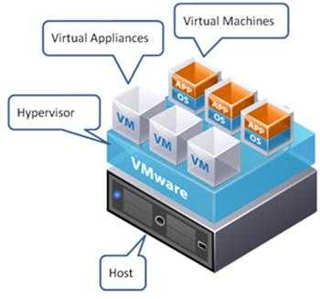
After Virtualization(x86)
Provisioning of VMs can be done on any system
OS and application work as a single unit
OS and applications are independent of hardware

Slide 7
Traditional Scenario- 2 server & its utilization

Slide 8
Moving from traditional scenario → virtualized

Slide 9
Utilization levels in Virtualized server

Slide 10
Lets use legos

Slide 11
Typical Physical Infrastructure for Enterprise

Slide 12
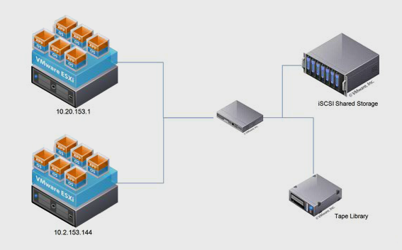
Virtualized Infrastructure for Enterprise

Slide 13
Virtualization Types
CPU Virtualization
Memory Virtualization
Device & I/O Virtualization
OS level Virtualization
Network Virtualization
Server Virtualization
Client/Desktop Virtualization
Application Virtualization

Slide 14
x86 Hardware Virtualization
● The x86 architecture offers four levels of privilege known as Ring 0, 1, 2 and 3 to
operating systems and applications to manage access to the computer hardware. While user level applications typically run in Ring 3, the operating system needs to have direct access to the memory and hardware and must execute its privileged instructions in Ring 0.
x86 privilege level
architecture without virtualization

Slide 15
Technique 1: Full Virtualization using Binary
Translation
● This approach relies on binary translation to trap (into the VMM) and to virtualize
certain sensitive and non-virtualizable instructions with new sequences of instructions
that have the intended effect on the virtual hardware. Meanwhile, user level code is directly executed on the processor for high performance virtualization.
Binary translation approach to x86 virtualization

Slide 16
Full Virtualization using Binary Translation
●
This combination of binary translation and direct execution provides Full
Virtualization as the guest OS is completely decoupled from the underlying
hardware by the virtualization layer.
●
The guest OS is not aware it is being virtualized and requires no
modification.
●
The hypervisor translates all operating system instructions at run-time on
the fly and caches the results for future use, while user level instructions run unmodified at native speed.
●
VMware’s virtualization products such as VMWare ESXi and Microsoft
Virtual Server are examples of full virtualization.

Slide 17
Full Virtualization using Binary Translation
● The performance of full virtualization may not be ideal because it involves
binary translation at run-time which is time consuming and can incur a large
performance overhead.
● The full virtualization of I/O – intensive applications can be a challenge.
● Binary translation employs a code cache to store translated hot instructions
to improve performance, but it increases the cost of memory usage.
● The performance of full virtualization on the x86 architecture is typically 80%
to 97% that of the host machine.

Slide 18
Technique 2: OS Assisted Virtualization
or Paravirtualization (PV)
● Paravirtualization refers to communication between the guest OS and the
hypervisor to improve performance and efficiency.
● Paravirtualization involves modifying the OS kernel to replace
nonvirtualizable instructions with hypercalls
the virtualization layer hypervisor.
that
communicate
directly
with
● The hypervisor also provides hypercall
interfaces for other critical kernel
operations such as memory
management, interrupt
handling and time keeping.
Paravirtualization
approach to x86 Virtualization

Slide 19
Technique 3: Hardware Assisted Virtualization
(HVM)
● Intel’s Virtualization Technology (VT-x) (e.g. Intel Xeon) and AMD’s AMD-V
both target privileged instructions with a new CPU execution mode feature
that allows the VMM to run in a new root mode below ring 0, also referred to
as Ring 0P (for privileged root mode)
(for de-privileged non-root mode).
while
the
Guest
OS
runs
in
Ring
0D
● Privileged and sensitive calls are
set to automatically trap to the
hypervisor and handled by
hardware, removing the need
for either binary translation or
para-virtualization.
● Vmware only takes advantage
of these first generation
hardware features in limited
cases such as for 64-bit guest
support on Intel processors.

Slide 20
Summary Comparison of the Current
State of x86 Virtualization Techniques

Slide 21
Full Virtualization vs. Paravirtualization
●
Paravirtualization is different from full virtualization, where the unmodified
OS does not know it is virtualized and sensitive OS calls are trapped using
binary translation at run time. In paravirtualization, these instructions are handled at compile time when the non-virtualizable OS instructions are replaced with hypercalls.
●
The advantage of paravirtualization is lower virtualization overhead, but the
performance advantage of paravirtualization over full virtualization can vary greatly depending on the workload. Most user space workloads gain very little, and near native performance is not achieved for all workloads.
●
As paravirtualization cannot support unmodified operating systems (e.g.
Windows 2000/XP), its compatibility and portability is poor.

Slide 22
Full Virtualization vs. Paravirtualization
● Paravirtualization can also introduce significant support and maintainability
issues in production environments as it requires deep OS kernel modifications. The invasive kernel modifications tightly couple the guest OS to the hypervisor with data structure dependencies, preventing the modified guest OS from running on other hypervisors or native hardware.
● The open source Xen project is an example of paravirtualization that
virtualizes the processor and memory using a modified Linux kernel and virtualizes the I/O using custom guest OS device drivers.

Slide 23
Memory Virtualization
●
This involves sharing the physical system memory and dynamically
allocating it to virtual machines. VM memory virtualization is very similar to
the virtual memory support provided by modern operating systems.
●
The operating system keeps mappings of virtual page numbers to physical
page numbers stored in page tables. All modern x86 CPUs include a memory management unit (MMU) and a translation lookaside buffer (TLB) to optimize virtual memory performance.
●
To run multiple virtual machines on a single system, another level of
memory virtualization is required. In other words, one has to virtualize the
MMU to support the guest OS.

Slide 24
Memory Virtualization
● The guest OS continues to control the mapping of virtual addresses to the
guest memory physical addresses, but the guest OS cannot have direct
access to the actual machine memory.
● The VMM is responsible for mapping guest physical memory to the actual machine memory, and it uses shadow page tables to accelerate the mappings.
● The VMM uses TLB hardware to map the virtual memory directly to the
machine memory to avoid the two levels of translation on every access.

Slide 25
I/O Virtualization
●
I/O Virtualization involves managing the routing of I/O requests between virtual devices and the shared physical hardware.
●
The hypervisor virtualizes the physical hardware and presents each virtual machine with a standardized set of virtual devices.
●
These virtual devices effectively emulate well-known hardware (with device drivers) and translate the virtual machine requests to the system hardware.
●
This standardization on consistent device drivers also helps with virtual machine standardization and portability across platforms as all virtual machines are configured to run on the same virtual hardware regardless of the actual physical hardware in the system.

Slide 26
I/O Virtualization in Xen: Indirect
driver model
●
Xen uses an indirect driver design that routes virtual machine I/O through device drivers in the Windows or Linux management operating systems.
●
Xen uses an indirect split driver model consisting of a front-end driver
running in Domain U (user VMs) and the backend driver running in Domain
0. These two drivers interact with each other via a block of shared memory.
●
The front-end driver manages the I/O requests of the guest OS and the
backend driver is responsible for managing the real I/O devices and
multiplexing the I/O data of different VMs. These generic (standard)
backend drivers installed in Linux or Windows OS can be overtaxed by the
activity of multiple virtual machines and
are not optimized for multiple VM workloads.
●
There is also CPU overhead associated
with this approach because I/O is proxied
via Domain 0.

Slide 27
I/O Virtualization in VMWare ESXi:
Direct driver model
● ESXi uses a direct driver model that locates the device drivers that link
virtual machines to physical devices directly in the ESXi hypervisor.
● With the drivers in the hypervisor, VMware ESXi uses optimized and
hardened device drivers and provides special treatment, in the form of CPU scheduling and memory resources, that they need to process I/O loads from multiple virtual machines.

Slide 28
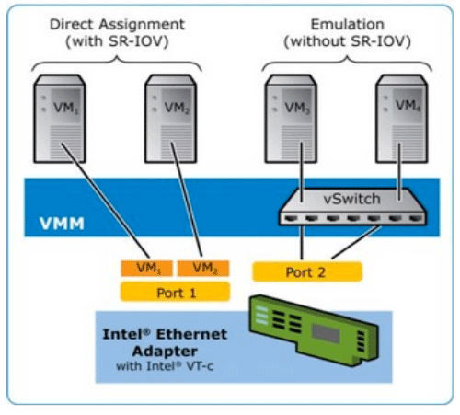
Network Virtualization

Slide 29
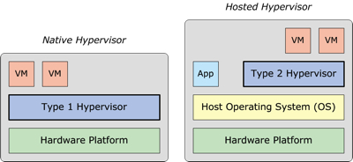
Types of Hypervisors

Slide 30
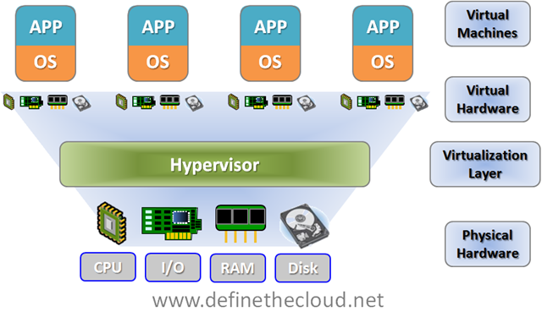
Virtualized Environment

Slide 31
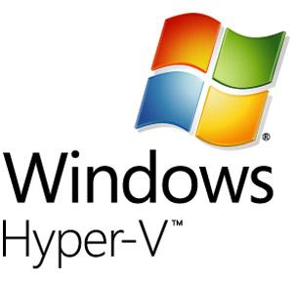
Virtualization Solutions by Entreprise
VMware ESX and ESXi
Citrix Xen Server
Hyper-V
Oracle Virtual Box
KVM
Virtual PC

Slide 32
Queries?

